Slide 1
Data Mining

Slide 2
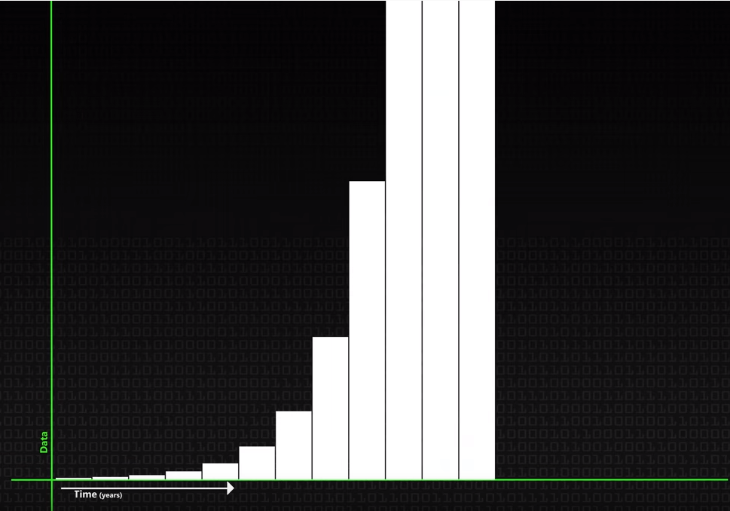

Slide 3
Data Mining Overview
Data Mining Is Data Mining
Can study the data without formulating a hypothesis first
Uncovers relationships or patterns by induction
Explores existing data, finding important factors that an analyst might never have included in a hypothesis

Slide 4
Data Mining Overview
Data Mining
“Discovering new information from very large data sets.”
“Study the data without forming a hypothesis first.”
Requires a large database or data warehouse
If none exists, you must perform cleansing, integration, and formatting before you can mine the data
Techniques:
Database Technology
Statistics
Artificial Intelligence

Slide 5
Data Mining Overview
Purpose of Data Mining
Prediction
Forecasting of future behavior or trends from given data
Classification
Place items into the correct categories based on known facts
Identification
Looking for existing activities or events
Examples: Insider trading, fraudulent insurance claims, etc.
Optimization
Model scenarios that help determine equipment placement, advertisement placement, how to invest money, or efficient time and equipment management

Slide 6
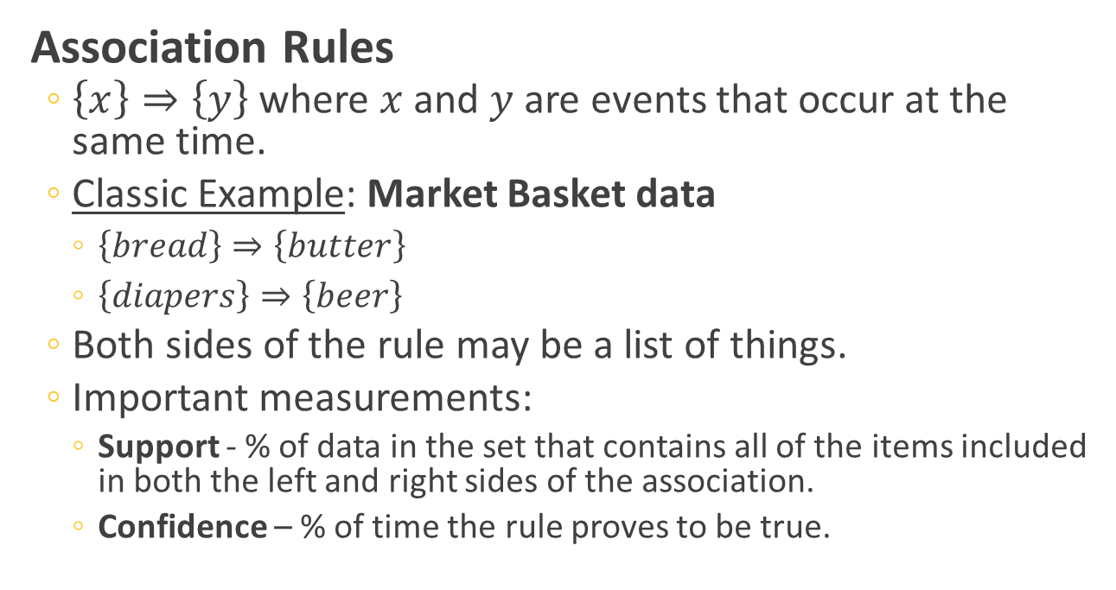
Data Mining Knowledge Discovery
Association Rules
$\left\{x\right\}⇒\left\{y\right\}$ where $x$ and $y$ are events that occur at the same time.
Classic Example: Market Basket data
$\left\{bread\right\}⇒\left\{butter\right\}$
$\left\{diapers\right\}⇒\left\{beer\right\}$
Both sides of the rule may be a list of things.
Important measurements:
Support - % of data in the set that contains all of the items included in both the left and right sides of the association.
Confidence – % of time the rule proves to be true.

Slide 7
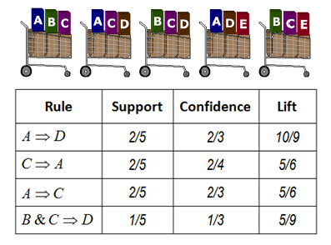
Data Mining Knowledge Discovery
Association Rules (2)
http://saedsayad.com/association_rules.htm

Slide 8
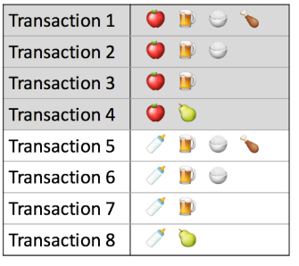
Example
In class activity
What is the support and confidence of the following items ?
the support of {apple , beer}?
the confidence of {apple -> beer}?
the support of {rice, meat} ?
the confidence of {rice -> meat} ?
the support of {rice, beer} ?
the confidence of {beer -> rice} ?
Notes:
28
34

Slide 9
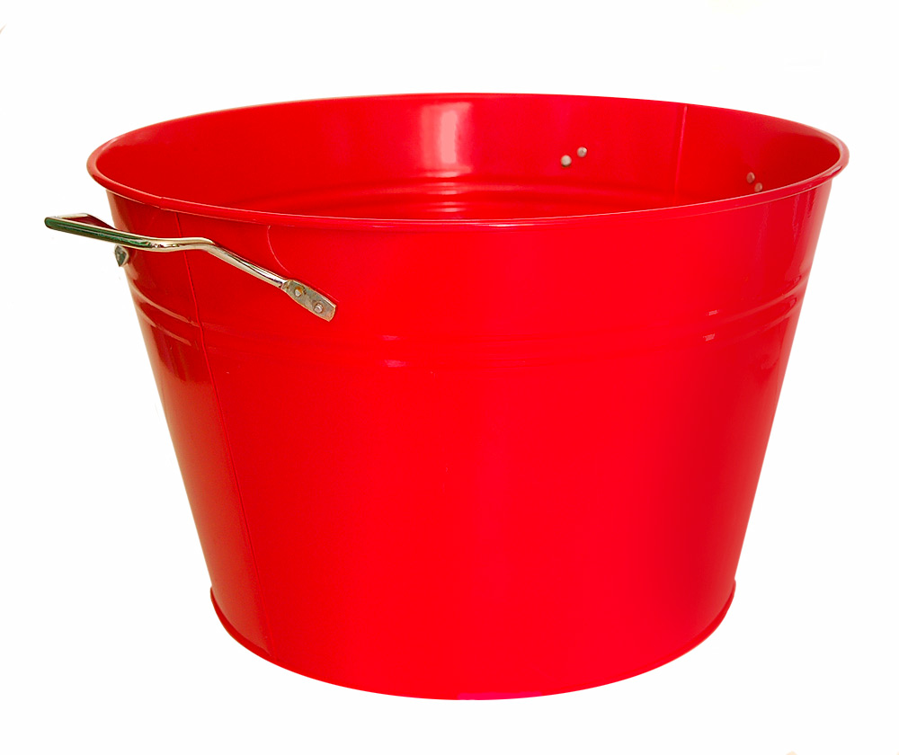
Data Mining Knowledge Discovery
Classification Rules
Place instances of data into the correct one of several categories.
Requires a training set, a set of data for which the correct categories are known.
This is not the same as categorization, which means the categories are unknown, but emerge from the data.
A
B
C
D

Slide 10
Data Mining Knowledge Discovery
Sequential Patterns
Prediction that a customer who buys something in one transaction will follow up with the purchase of another related item in another transaction.
Time Series Patterns
A time series is a sequence of events that are all the same type.
You can study time series to discover patterns and sequences.
Example: Longest period when sales figures increase each month

Slide 11
Data Mining Process
Business Understanding
The requirements and objectives of the project
Data Understanding
Understand how the data looks and feels. Subsets?
Data Preparation
Remove outliers if they exist, or at least highlight them.
Modeling
Choose HOW to perform the data mining. This depends on the outcome you desire.
Evaluation – The model is tested and validated
Deployment – The model is put into use

Slide 12
Data Mining Models
Regression (Statistics)
A statistical method for predicting the value of an attribute, Y, (the dependent variable), given the values of attributes X₁, X₂, …, X_{n} (the independent variables).
Linear Regression
The package finds the contribution or weight of each independent variable, as coefficients, a₀, a₁, …, a_{n} for a linear function Y= a₀ + a₁ X₁ + a₂ X₂ + … + a_{n}X_{n}
Non-Linear Regression
Finding a curve that fits the observed values

Slide 13

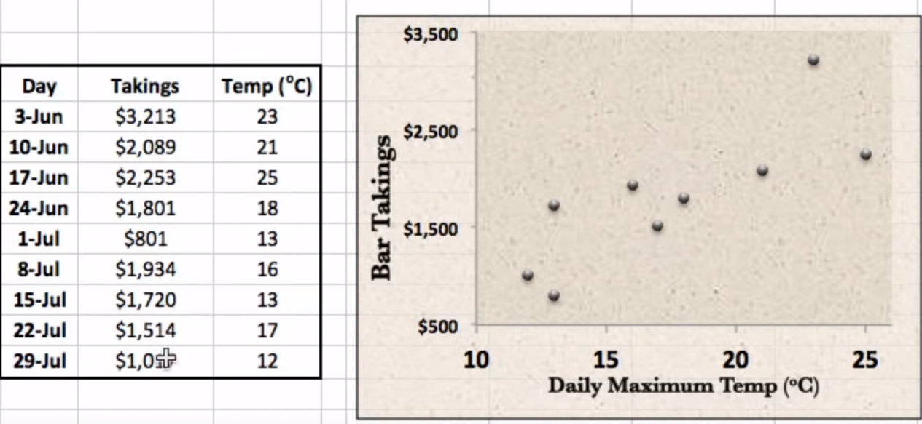

Slide 14
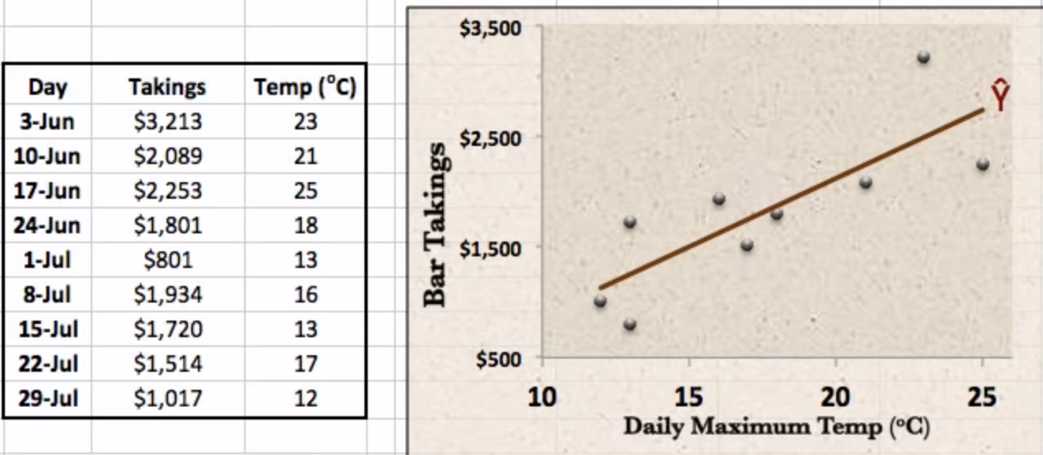

Slide 15
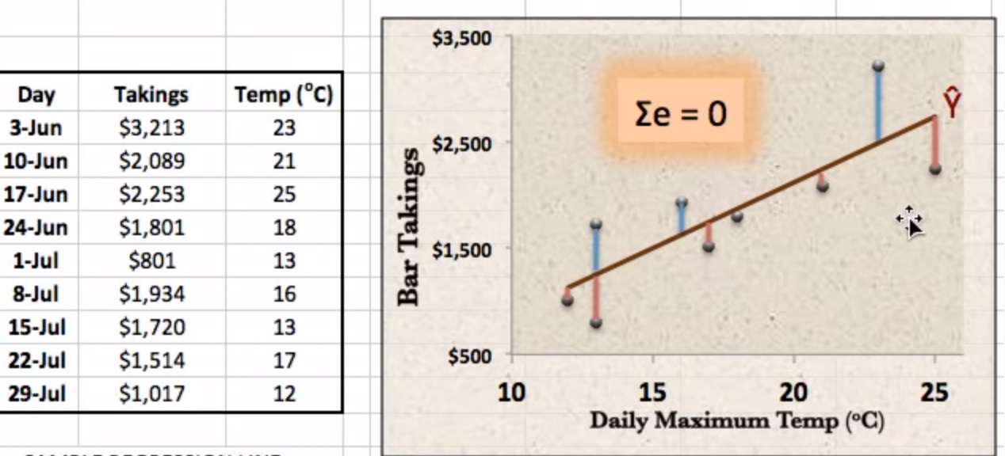

Slide 16
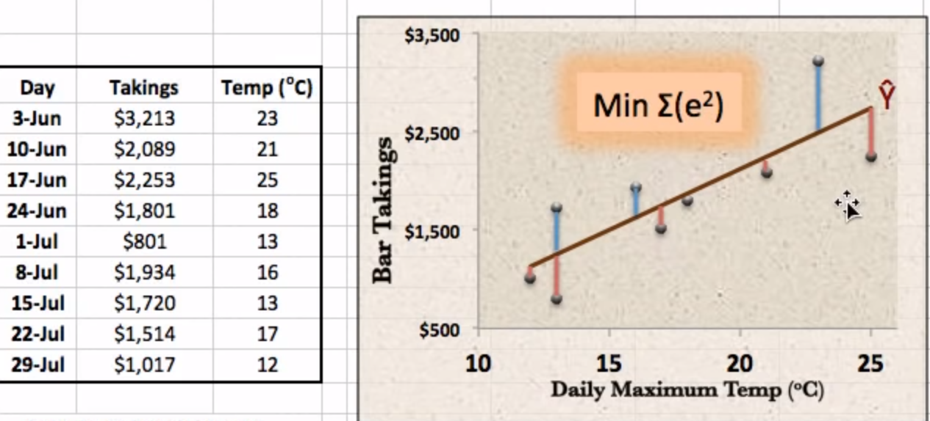

Slide 17
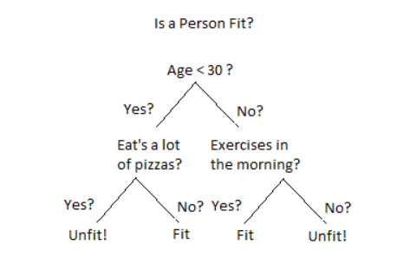
Data Mining Models Decision Trees

Slide 18
Data Mining Models
Decision Trees (Classification)
A tree is developed by examining past data to determine how significant attributes and values are related to outcomes
Nodes of the tree represent partitioning attributes, which allow the set of training instances to be partitioned into disjoint classes
The partitioning conditions are shown on the branches
Tree is then used to classify new cases

Slide 19
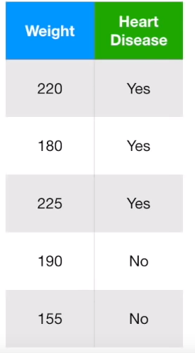
Best value to divide the patients

Slide 20
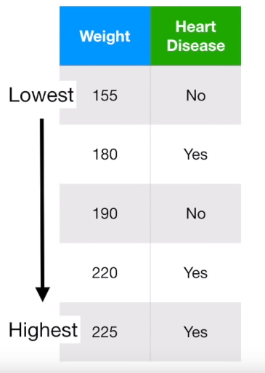
Sort

Slide 21
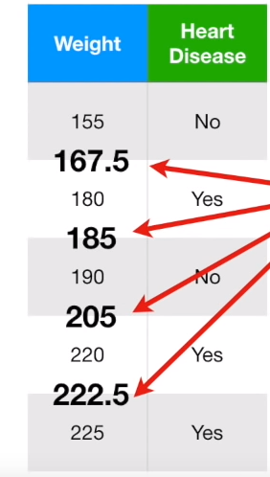
Average adjacent values

Slide 22
Average adjacent values
If weight >205 -> heart disease
If weight <205 -> No

Slide 23
Average adjacent values
If weight >205 -> heart disease
If weight <205 -> No
What is the accuracy?
Is the best accuracy possible
based on the data ?
Use Gini impurity scores…

Slide 24
Activity: Construct a decision tree
Gender | weight | Heart Disease
M | 155 | No
F | 180 | Yes
M | 190 | No
F | 220 | Yes
M | 225 | Yes
F | 172 | No

Slide 25
Data Mining Models
Neural Networks
Non-linear models that resemble biological neural networks
Use a set of samples to find the strongest relationships between variables and observations
Flow:
Network receives a training set that provides facts about input values
Using a learning method, adapt as the nodes learn new information from additional samples
Hidden layers are developed by the system as it examines cases, using generalized regression technique
The system refines its hidden layers until it has learned to predict correctly a certain percentage of the time
Provide test cases to evaluate it

Slide 26
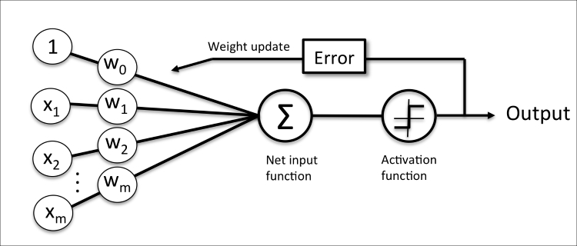
Data Mining Models
Neural Networks
Single-Layer Perceptron Network
(Raschka, 2015)

Slide 27
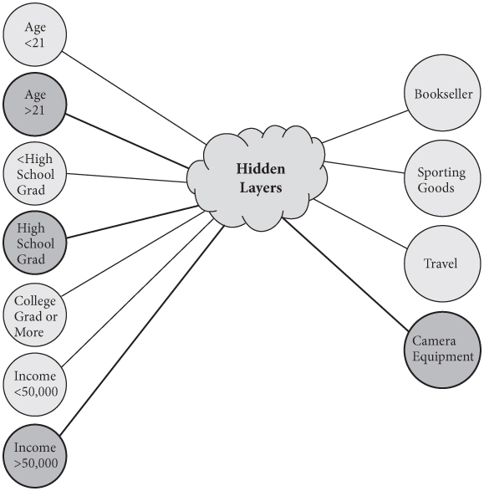
Data Mining Models
Neural Networks
Multi-Layer Perceptron Network
Contains hidden layers
Required if the data is not linearly separable

Slide 28
Data Mining Models
Neural Networks
Problems
Overfitting –
Prediction function fits the training set values too perfectly, even ones that are incorrect (data noise)
Prediction function will then perform poorly on new data
Knowledge of how the system makes its predictions is in the hidden layers: users do not see the reasoning
Output may be difficult to understand and interpret

Slide 29
Data Mining Models
Clustering (Categorization)
Methods used to place cases into clusters or groups that can be disjoint or overlapping
Using a training set, the system identifies a set of clusters into which the tuples of the database can be grouped
Tuples in each cluster are similar, and they are dissimilar to tuples in other clusters
Similarity is measured by using a distance function defined for the data

Slide 30
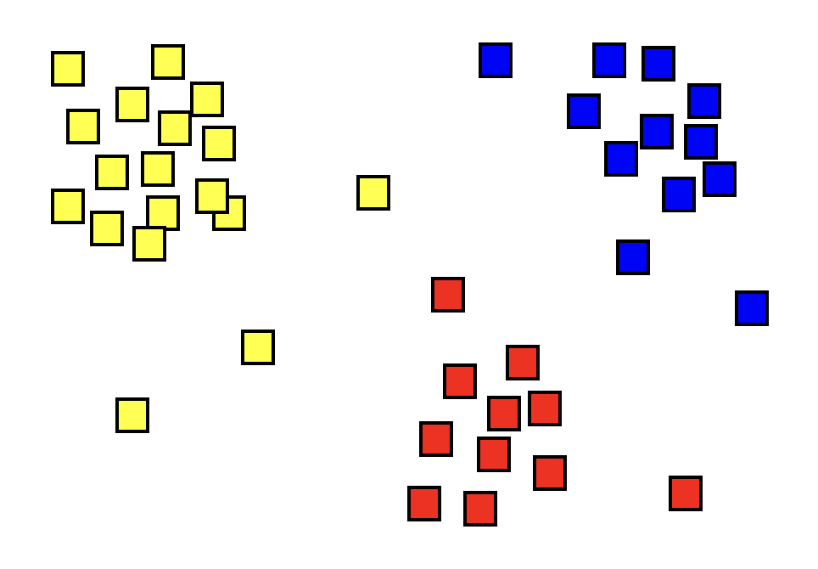
Data Mining Models
Clustering (Categorization)

Slide 31
Data Mining Applications
Retail
Customer Relationship Management
Advertising Campaign Management
Banking and Finance
Credit Scores
Fraud Detection and Prevention
Manufacturing
Optimization
Product Design

Slide 32
Data Mining Applications
Science and Medicine
Treatment Effectiveness
Drug Effectiveness
Finding Relationships
Astronomy
Weather Prediction
Bioinformatics

Slide 33
References
Elmasri & Navathe (2011). Fundamentals of Database Systems, 6th Ed.
Ricardo, C.M., & Urban, S.D. (2017). Databases Illuminated, 3rd Ed. Jones & Bartlett Learning: Burlington, MA.

